Slide 1


Bài giảng điện tử
Unit Starter
Lesson 7: Vocabulary

Slide 2


Slide 3
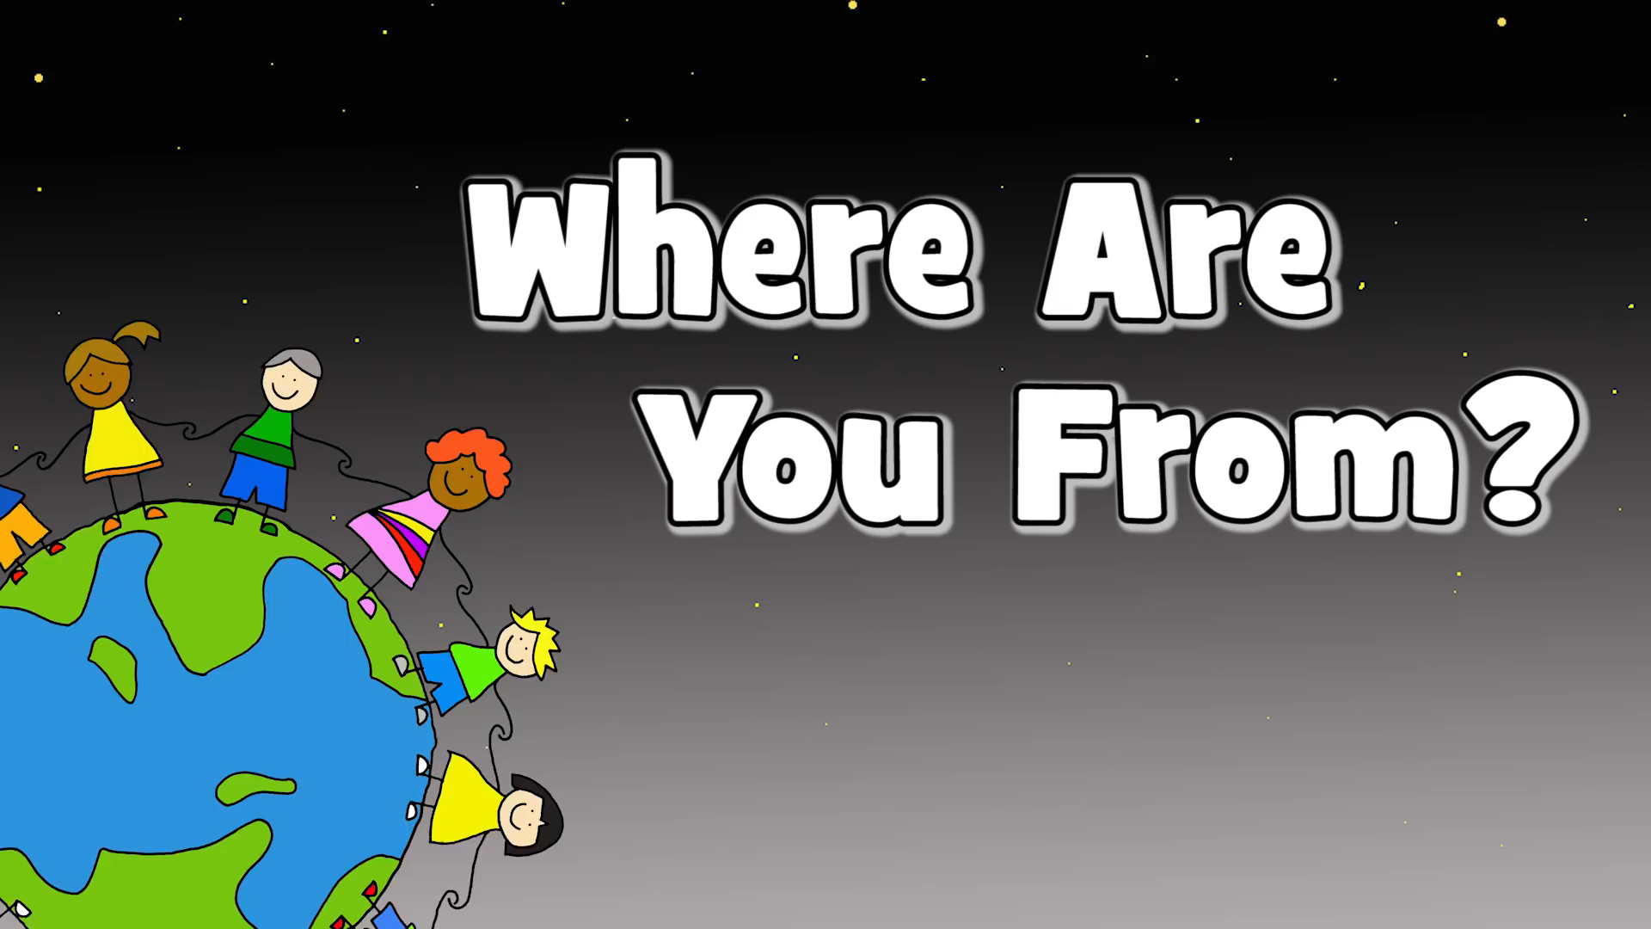

Slide 4
Starter unit
Lesson 7
Vocabulary
COUNTRIES AND NATIONALITIES

Slide 5
Structures
Where + am/is/are + S + from?
➔ S + am/is/are + from + (country)
Example:
Where are you from?
➔ I am from Vietnam.

Slide 6
Structures
What + tobe + her/his/your….nationality ?
(am, is, are) (nationalities)
➔ S + am/is/are + (nationality)
Example:
What is your nationality?
➔ I am Vietnamese.

Slide 7
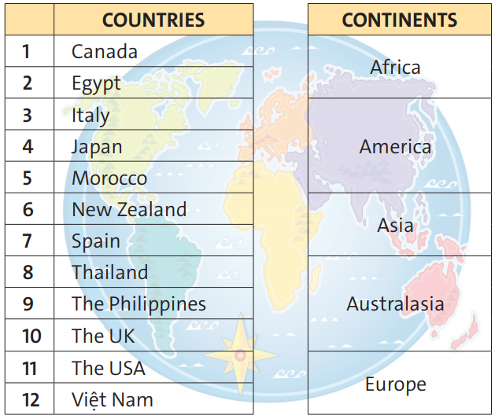

Exercise 1
2, 5
1, 11
4, 8, 9, 12
6
3, 7, 10

Slide 8
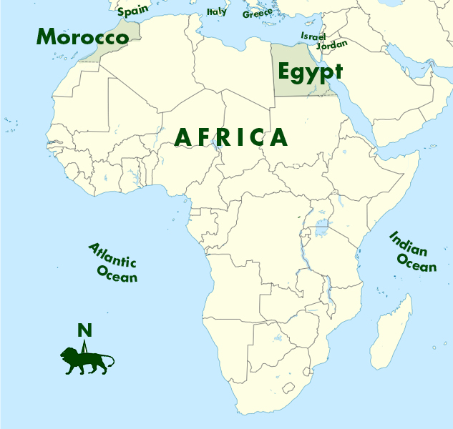
New words
Morocco (n) /məˈrɑː.koʊ/
Egypt (n) /ˈiː.dʒɪpt/

Slide 9
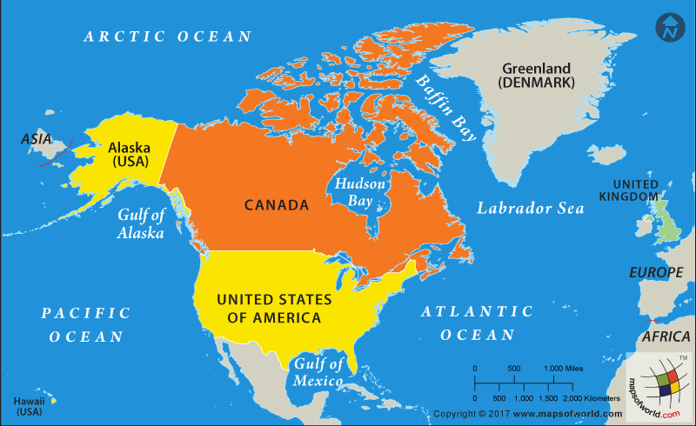
Canada (n) /ˈkæn.ə.də/
The USA (n) /ˌjuː.esˈeɪ/ = the United States of America

Slide 10
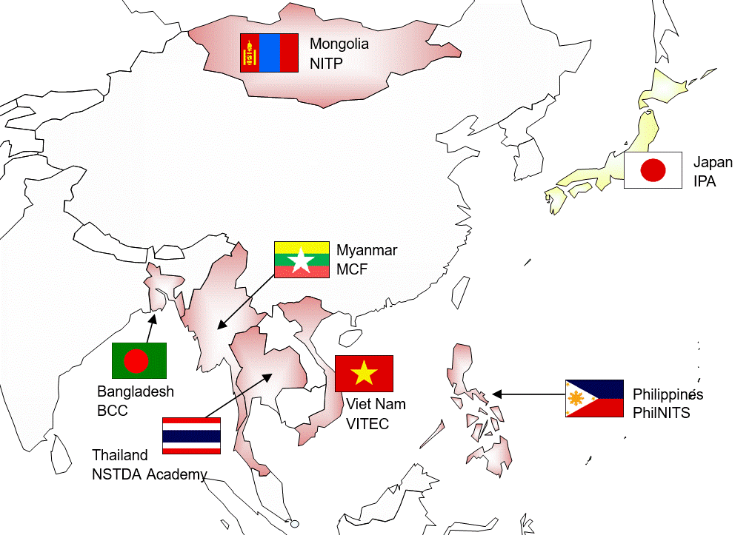
Japan (n) /dʒəˈpæn/
Thailand (n) /ˈtaɪ.lænd/
The Philippines (n) /ˈfɪl.ə.piːnz/

Slide 11
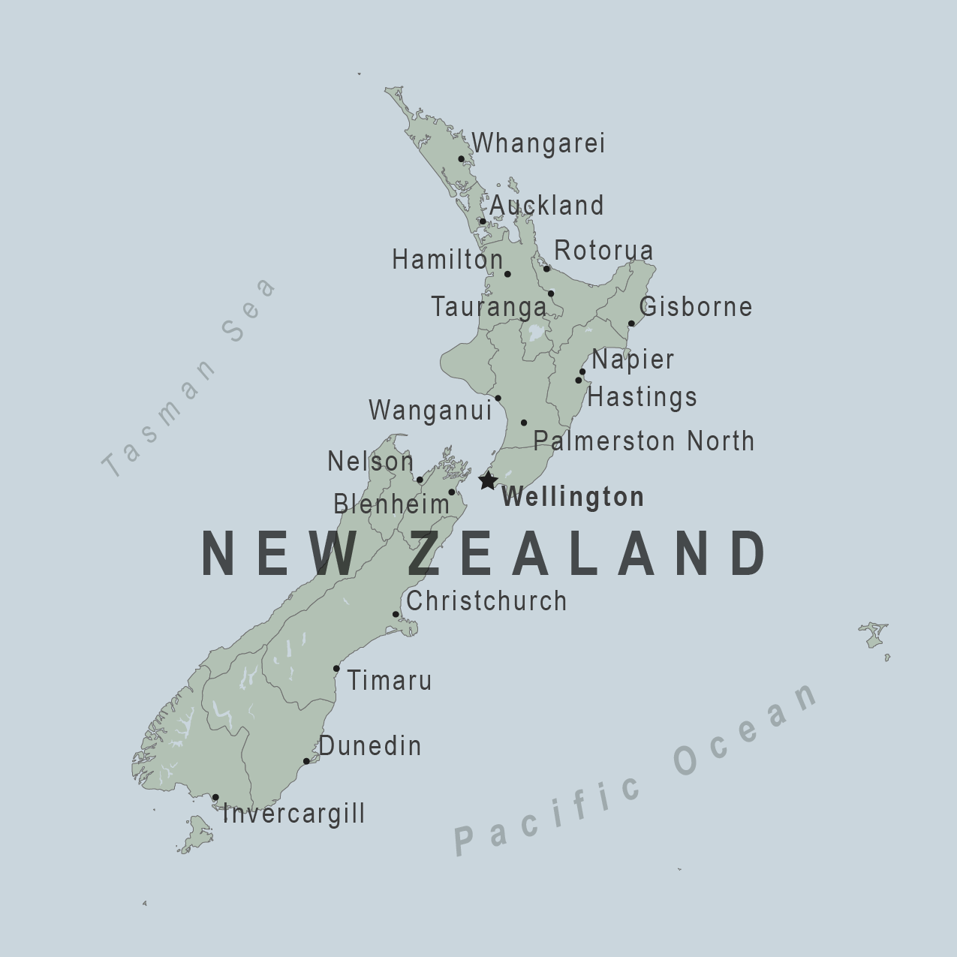
New Zealand (n)
/ˌnjuː ˈziː.lənd/

Slide 12
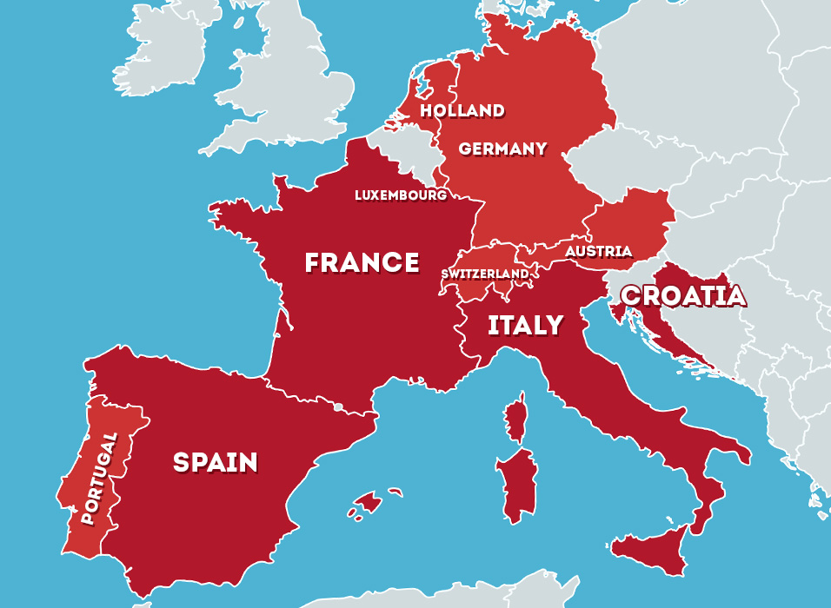
Italy (n) /ˈɪt̬.əl.i/
Spain (n) /speɪn/

Slide 13
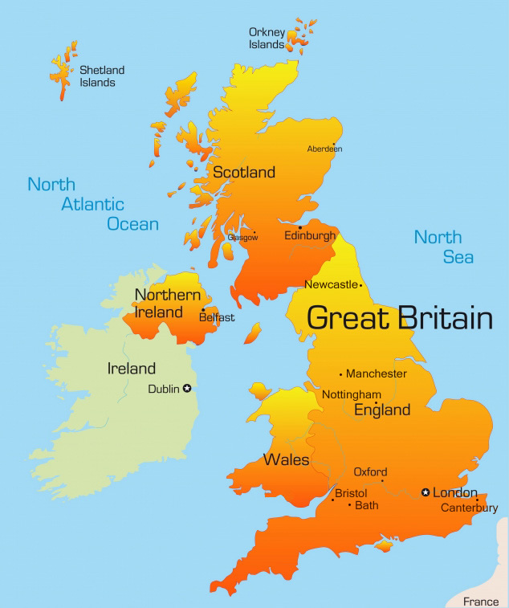
The UK (n) /ˌjuːˈkeɪ/
= United Kingdom

Slide 14


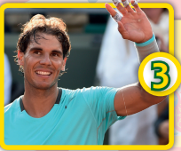
Exercise 2
People from the UK
are British / American.
The Vietnamese / Japanese
flag is red and yellow.
Rafael Nadal is a Spanish /
Canadian sports star.

Slide 15
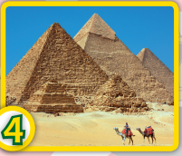

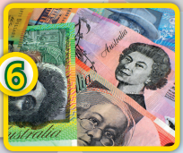
Cairo is the Egyptian/ Moroccan capital.
Tom Yum is Thai / Italian food.
The dollar is the British /Australian currency.

Slide 16
Exercise 3
Country | Nationality
1. The USA
2. Canada
3. Egypt
4. Italy
5. Japan
American
Canadian
Egyptian
Italian
Japanese

Slide 17
Moroccan
6. Morocco
7. New Zealand
8. Spain
9. Thailand
10. The Philippines
11. The UK
12. Vietnam
New Zealander
Spanish
Thai
Filipino
British
Vietnamese

Slide 18

Exercise 4

Slide 19

- Learn by heart all the new words and the structures.
- Prepare for next lesson – Language focus: Question words: Where...? What....? Who....?/ Conjunctions: and/or/but.

Slide 20



www.phuongnam.edu.vn

